Slide 1
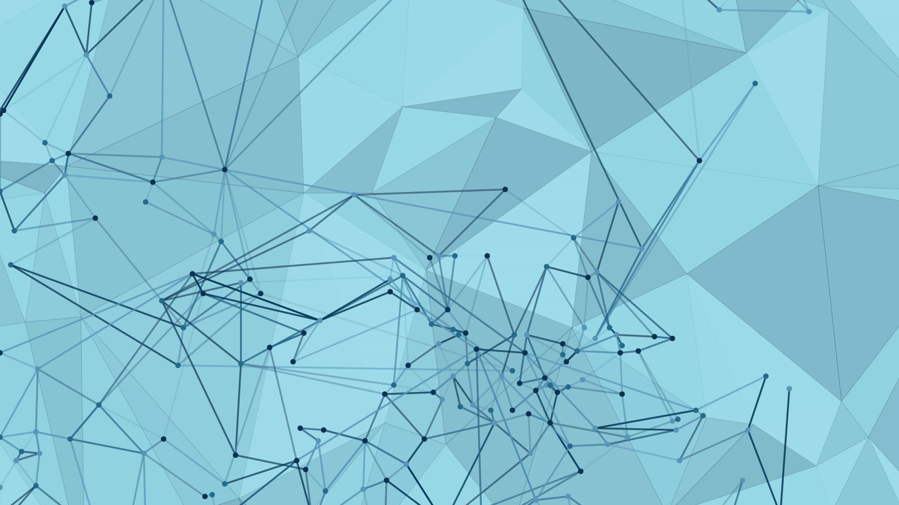
Drug Review Prediction
Sonali Panigrahi

Slide 2
AI in HealthCare
AI healthcare market, valued at $11 billion in 2021, is projected to be worth $187 billion in 2030.
Applications of AI in HealthCare:
Radiology using Image Recognition
AI-assisted documentation
Robotic surgery
Fraud detection in the healthcare industry
NLP systems can convert spoken or handwritten medical notes into structured electronic health records (EHRs)

Slide 3
Agenda
Problem Statement
Data
Exploratory Data Analysis
NLP & Labels Preprocessing
Modelling
Results
Limitations and Future Works

Slide 4
Problem Statement

Slide 5
Data
Data on drug name, condition (disease), rating & patient’s review
~215k reviews: split into train (75%) and test (25%) with 708 conditions
Null Values only in conditions column (0.55%)

Slide 6
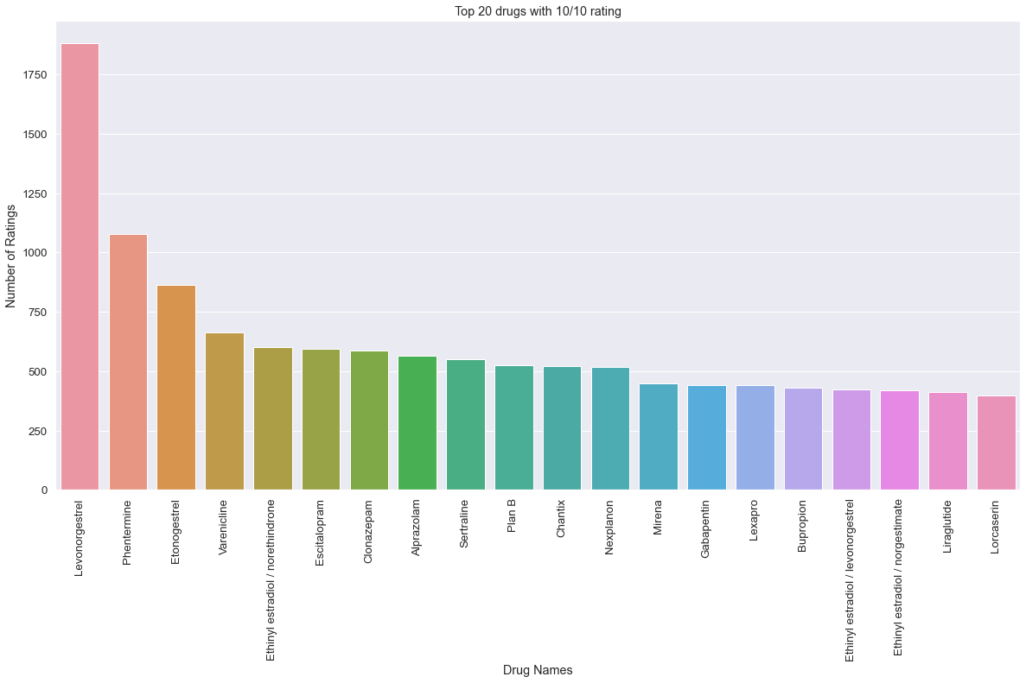
EDA

